Slide 1

Impact of Market Sentiment on Trader Performance
Exploratory Analysis using Bitcoin Fear–Greed Index and Hyper liquid Trade Data
Name-Lalin Budula
Email ID- lalinbudula@gmail.com
Submission Date- 09/01/2026

Slide 2
Problem Statement
Problem Statement
Financial markets are strongly influenced by trader psychology
Emotions like Fear and Greed affect:
Risk-taking
Trade frequency
Profitability
In crypto markets, this impact is amplified due to high volatility
Goal: Understand how market sentiment affects real trader performance.

Slide 3
Objective
Objective of the Project
Analyze the relationship between market sentiment and trader performance
Identify behavioral patterns under Fear and Greed
Measure impact on:
Profitability
Risk
Trading efficiency
Derive insights to support smarter trading strategies

Slide 4
Datasets Used
Datasets Used
1️⃣ Bitcoin Market Sentiment Dataset
2️⃣ Hyperliquid Trader Data
Daily sentiment classification: Fear / Greed
Real executed trades
Represents collective market psychology
Includes:
Trade size & price
Direction (Buy/Sell)
Realized PnL
Timestamps
📌 Trades were aligned with sentiment using trade date.

Slide 5


Data Preprocessing
Data Cleaning & Preparation
Standardized column names
Fixed timestamp parsing issues
Corrected timezone misalignment (IST)
Filtered only closed trades (realized PnL)
Merged daily sentiment with intraday trades
Final dataset: ✅ 26,064 valid trades

Slide 6
Methodology
Methodology
01
02
Time-align sentiment and trade data
Feature engineering:
Closed PnL
Win / Loss indicator
Trade size & volatility
03
04
Compare Fear vs Greed:
Trader-level consistency analysis
Profitability
Risk
Efficiency
📌 Exploratory, interpretable analysis (no ML used)

Slide 7
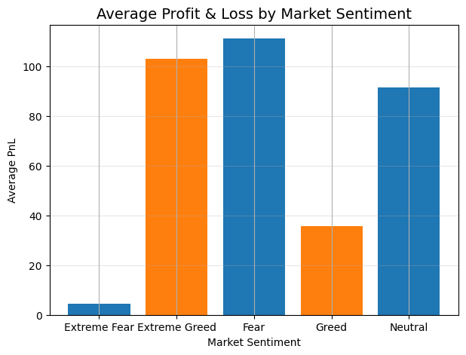
KEY INSIGHT 1: PROFITABILITY
Is Greed Actually Better Than Fear?
This chart illustrates the average realized Profit and Loss (PnL) across various market sentiment regimes, providing a clearer picture of how different emotional states impact individual trade profitability.
Key Observations
Fear-dominated periods demonstrate the highest average PnL, suggesting that cautious and selective trading can be highly profitable.
Greed-driven markets, despite often having higher activity, yield lower average PnL per trade compared to Fear or Neutral states.
Extreme Fear results in the lowest average PnL, indicating that paralyzing fear can lead to missed opportunities or poor execution.
Extreme Greed performs better than moderate Greed, but this often comes with significantly higher, unquantified risk, as traders might take on excessive leverage or position sizes.
Insight
Higher optimism does not guarantee higher profitability; disciplined trading during periods of moderate caution often yields superior risk-adjusted returns.

Slide 8
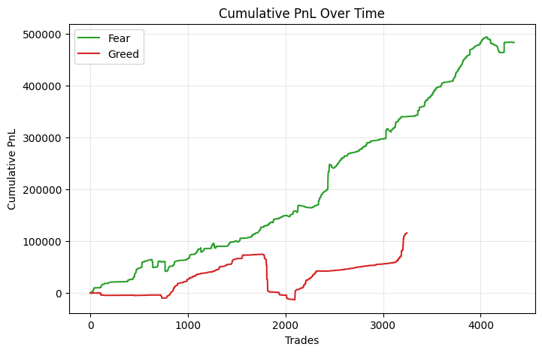
KEY INSIGHT 2: PnL over Time
How Does Profitability Evolve Over Time?
This chart illustrates the cumulative realized Profit and Loss (PnL) over various time periods, comparing performance during prevailing 'Fear' versus 'Greed' market sentiment regimes.
Cumulative PnL (Fear)
Cumulative PnL (Greed)
Key Observations
Fear-driven periods demonstrate a steady and sustained upward trend in cumulative PnL, indicating consistent growth.
Greed phases initially show quick gains but are often followed by significant drawdowns and sharp reversals in cumulative PnL.
Recovery after losses in Greed periods is typically slow, highlighting greater instability and prolonged periods of underperformance.
Insight
Consistent, disciplined gains, characteristic of Fear periods, contribute more to long-term profitability than the volatile, short-term spikes often seen during Greed.

Slide 9
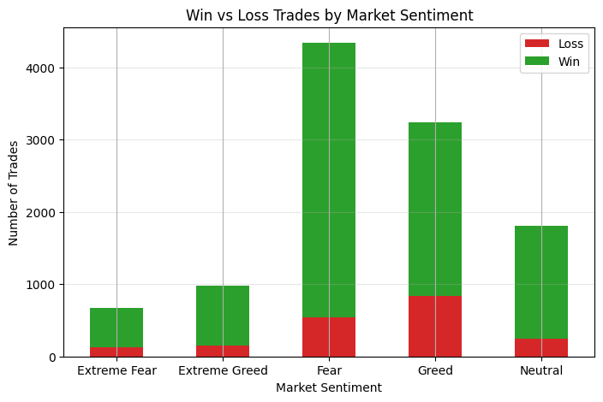
KEY INSIGHT 3: Success VS Activity
Success vs Activity Across Market Sentiment
This stacked bar chart illustrates the balance between winning and losing trades across different market sentiment regimes, shedding light on whether increased trading activity correlates with greater success.
Winning Trades
Losing Trades
Key Observations
Greed shows a significantly higher number of total trades, indicating increased activity.
During periods of Greed, both winning and losing trades increase substantially, reflecting heightened market participation.
Despite the surge in activity, the overall win rate does not improve proportionally during Greed-driven sentiment.
Insight
More trades do not automatically translate to more success; maintaining a disciplined approach is crucial, especially during periods of high market optimism.

Slide 10
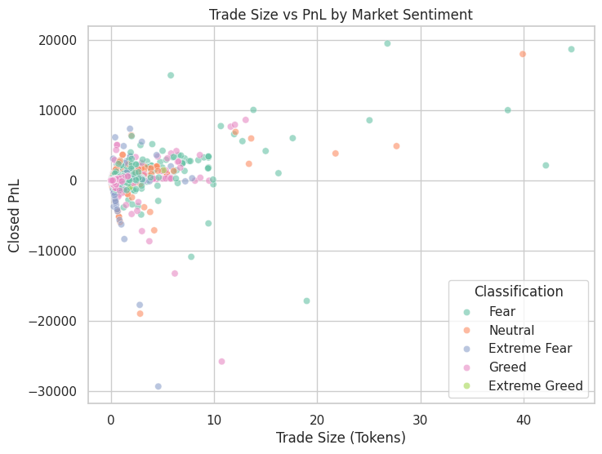
KEY INSIGHT 4: TRADE SIZE & RISK BEHAVIOR
How Trade Size Drives Risk and Losses
This scatter plot visually represents the relationship between individual trade size (in tokens) and the realized Profit and Loss (PnL), with each data point colored to indicate the prevailing market sentiment at the time of the trade. It highlights how position sizing interacts with market psychology to influence outcomes.
Key Observations
Larger trade sizes are consistently associated with more extreme PnL outcomes, both positive and negative.
The most significant negative outliers, representing substantial losses, are predominantly observed during periods of Greed and Extreme Greed.
Conversely, smaller trades tend to cluster closer to a zero PnL, effectively limiting potential downside risk.
Insight
Poor position sizing, particularly during periods of market Greed, is a critical factor contributing to significant trading losses.

Slide 11
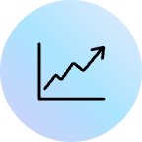

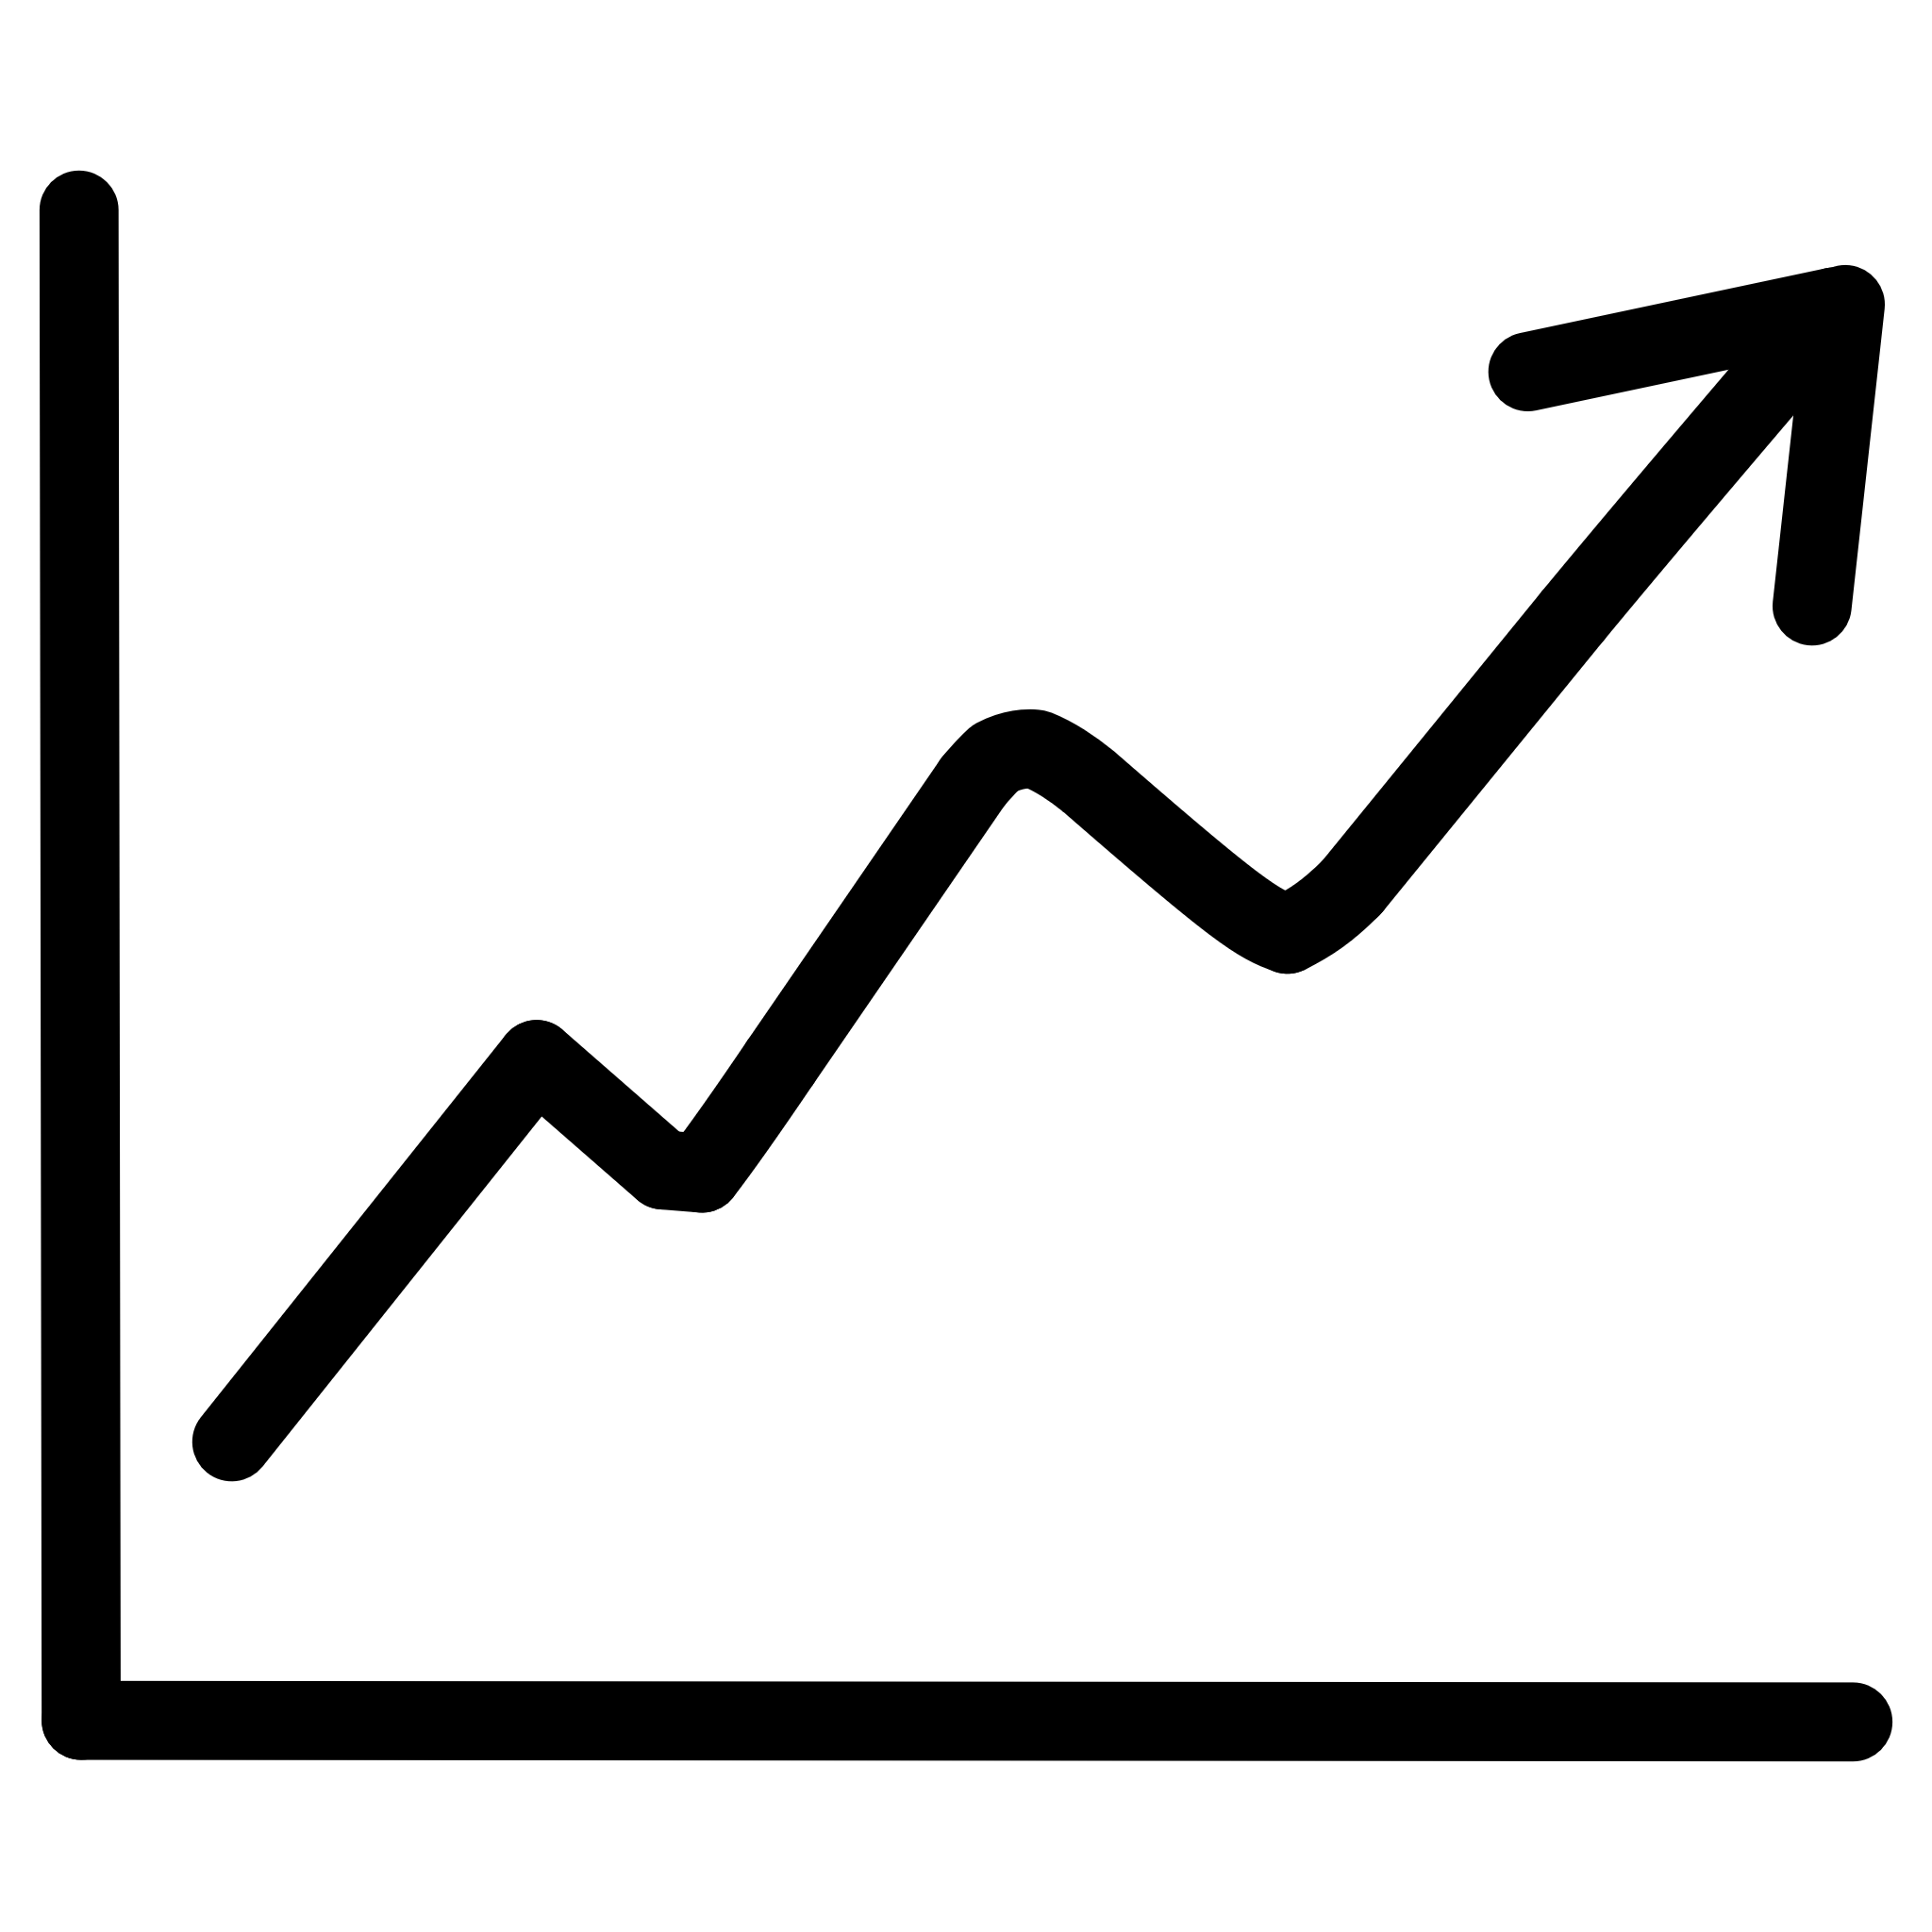


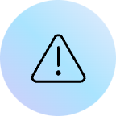



KEY INSIGHTS
Key Insights from the Analysis
Profitability
Trading Activity vs. Losses
Fear-dominated periods consistently outperform Greed in both average and cumulative profitability.
Increased trading activity during Greed periods also leads to a disproportionate increase in significant losses.
Consistent Win Rates
Trade Size & Risk
Despite higher trade volumes in Greed, win rates remain largely similar across different sentiment regimes, indicating no efficiency gain.
Large trade sizes, particularly during Greed and Extreme Greed, are direct drivers of amplified losses and heightened risk exposure.
Overarching Insight: Emotional trading, especially during periods of Greed, significantly increases risk exposure without a corresponding improvement in trading efficiency or profitability.

Slide 12

ACTIONABLE TRADING STRATEGIES
Actionable Trading Strategies
Based on our analysis, adopting these strategies can help traders navigate market sentiment more effectively and improve overall performance.
Control Position Size
Avoid Overtrading
Focus on Risk-Adjusted Returns
Reduce individual trade size during periods of Greed to mitigate the risk of amplified losses, especially when market optimism is high.
Resist the temptation to increase trading frequency or volume when market sentiment is excessively optimistic, as this often leads to disproportionate losses.
Prioritize consistency and capital preservation over chasing raw, high-volatility profits. Sustainable growth often comes from lower-risk trades.
Embrace Caution in Fear
Sentiment as Risk Signal
Recognize that disciplined trading during "Fear" periods tends to yield more stable and higher average PnL. Avoid paralysis and trade selectively.
Utilize market sentiment as a valuable risk-management indicator, rather than a direct trigger for entering or exiting trades. Adjust strategy accordingly.
Strategy: Control risk first — sustainable profits will follow.

Slide 13

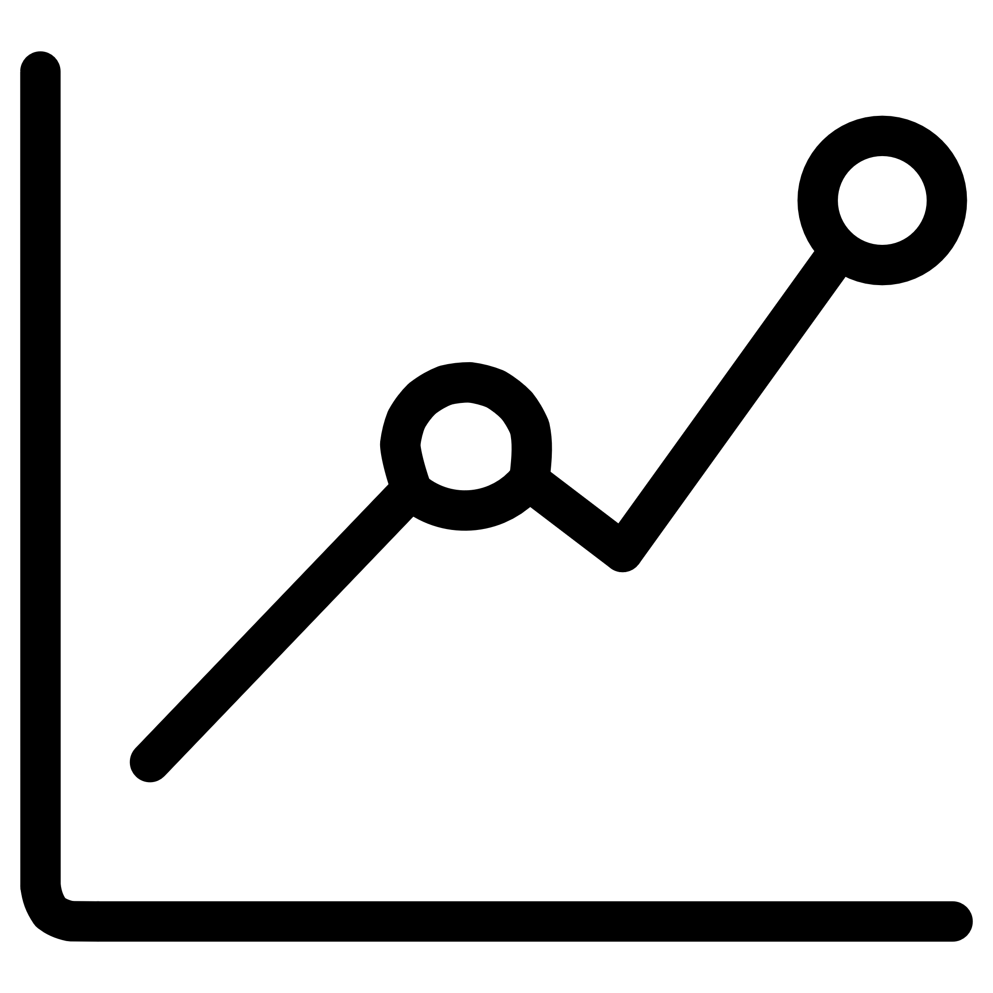
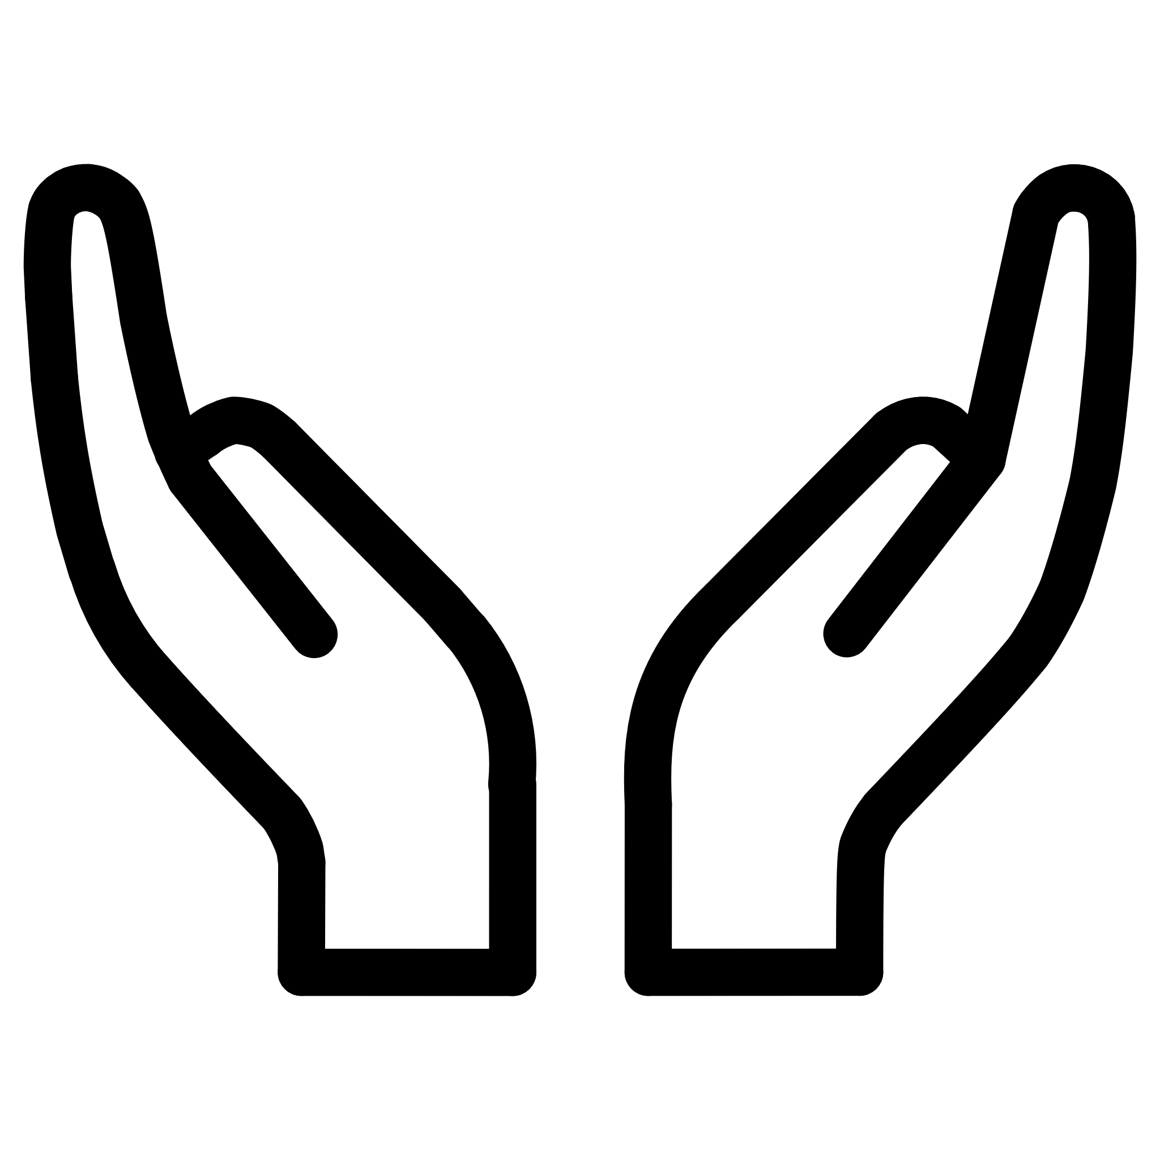
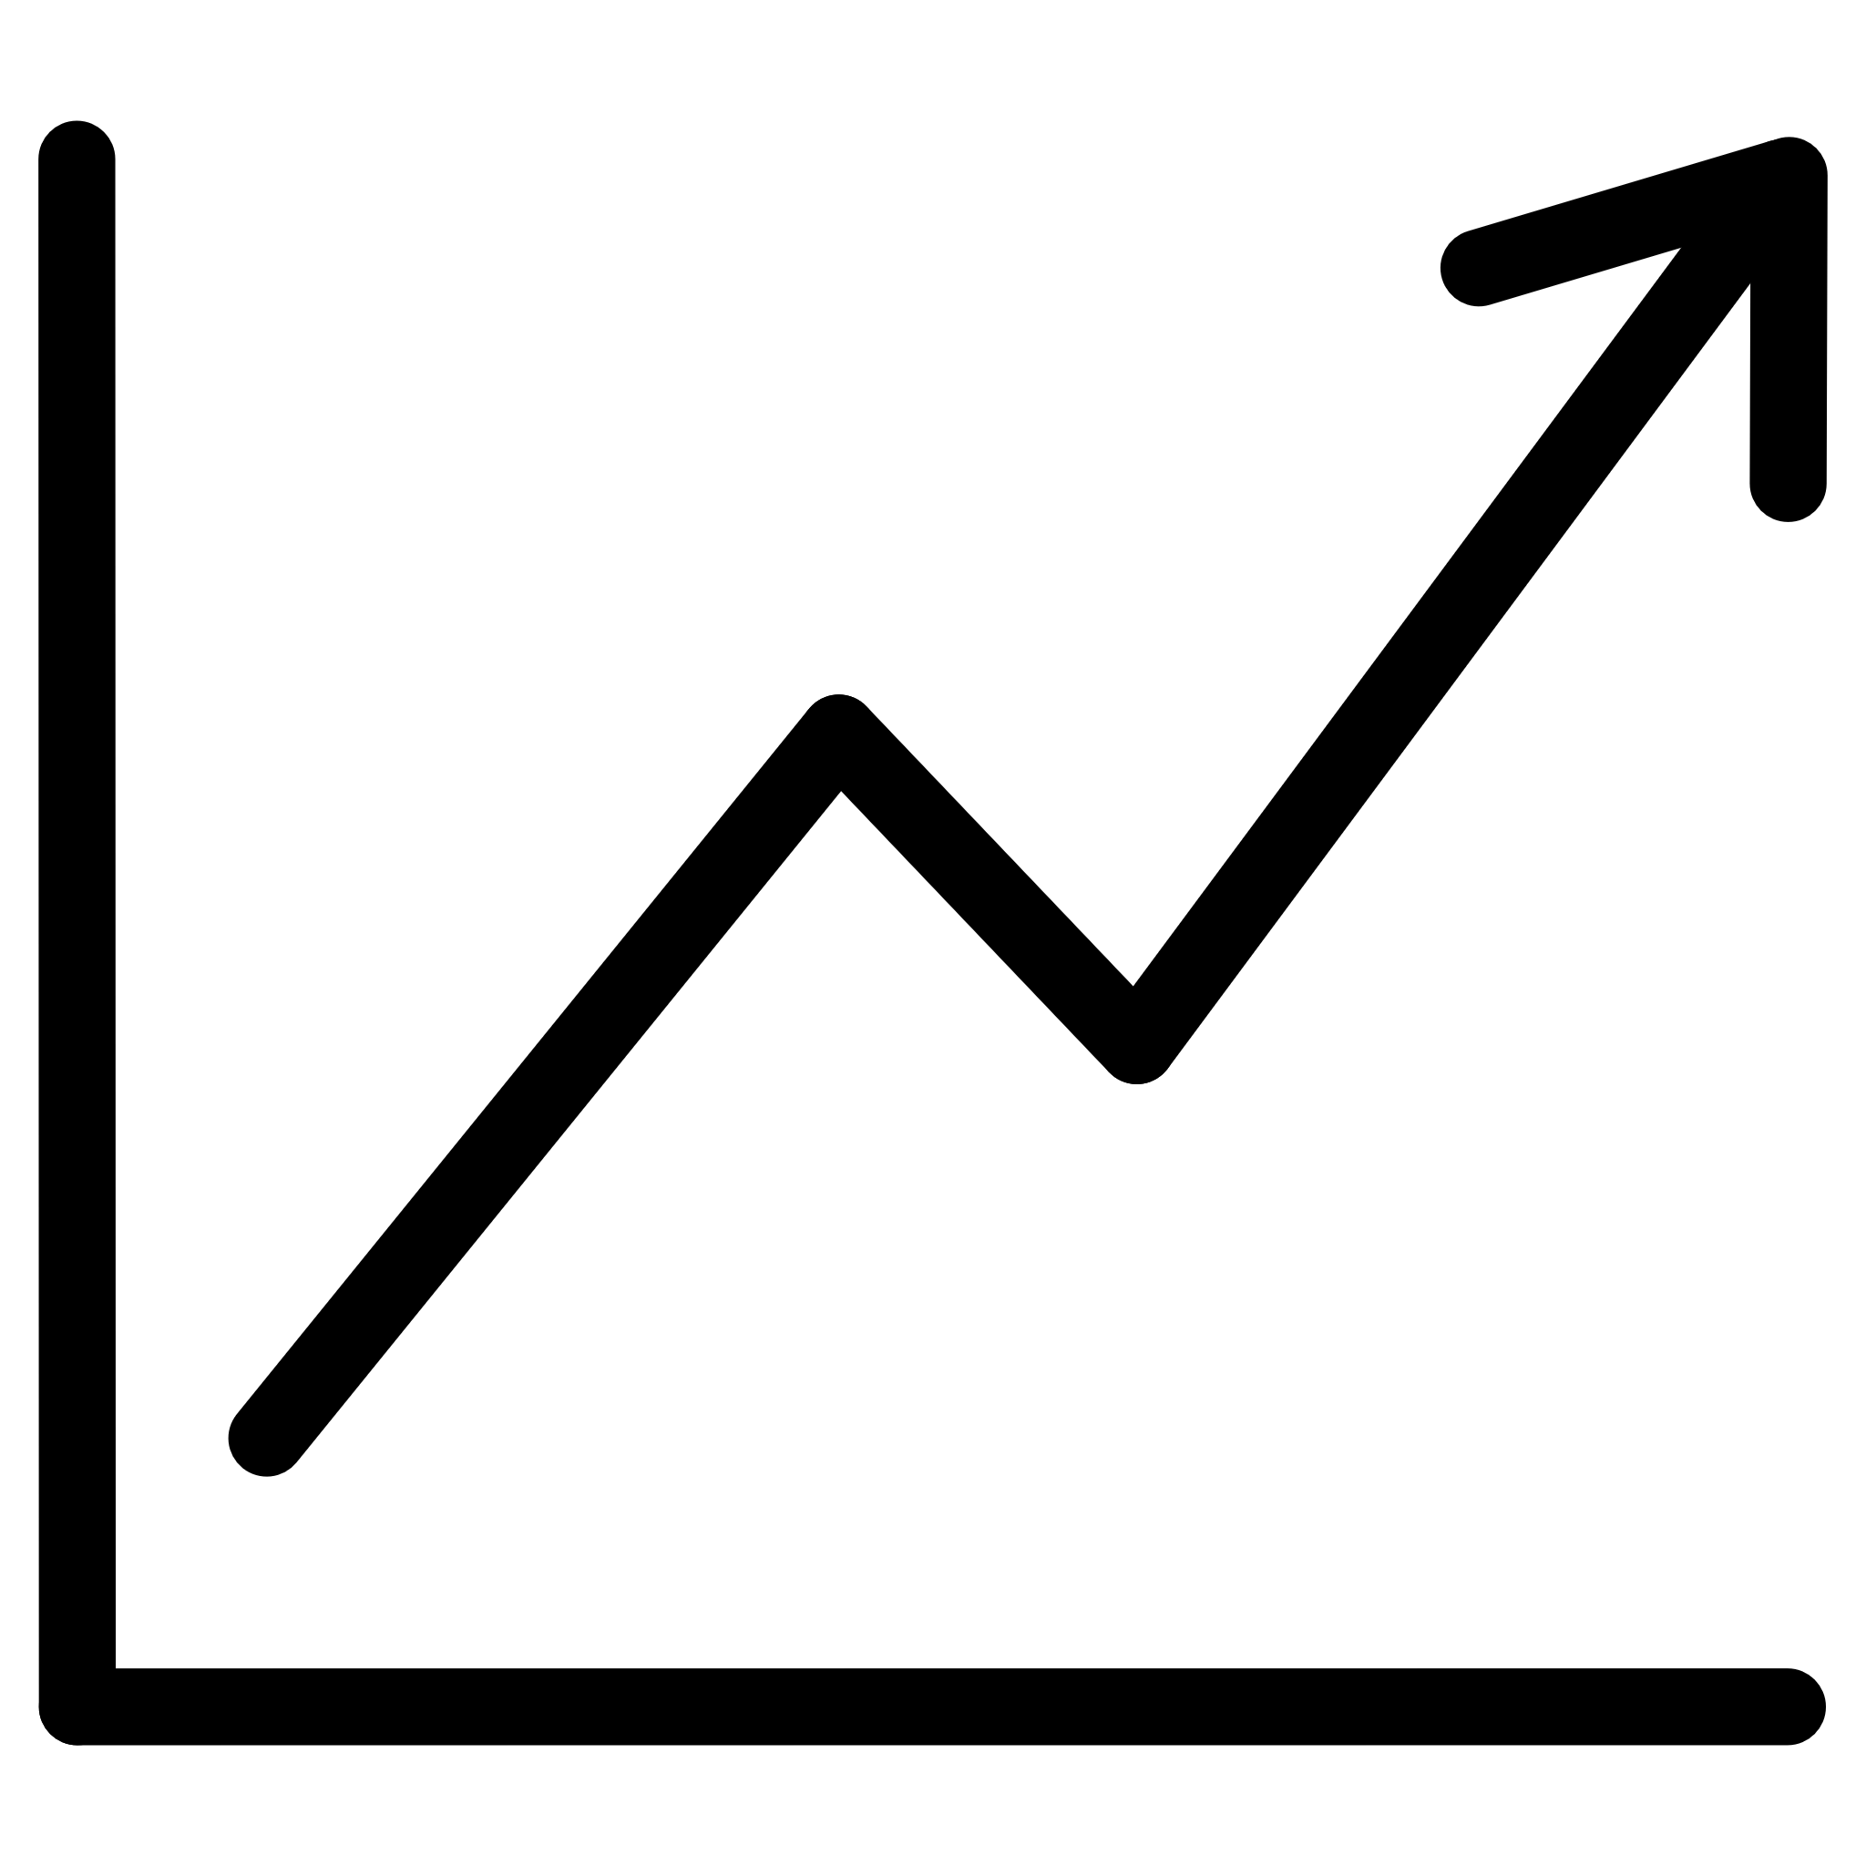


CONCLUSION
Key Insights for Smarter Trading
Our analysis reveals critical patterns in how market sentiment impacts trader performance and profitability, offering clear guidance for optimizing trading strategies.
Sentiment's Influence
Greed's Downfall
Market sentiment profoundly shapes trader behavior and subsequent financial outcomes.
Periods of greed increase risk and volatility without proportional improvements in trading efficiency or win rates.
Fear's Opportunity
Discipline & Sizing
Disciplined trading during 'fear' driven periods consistently supports more stable and sustainable long-term growth.
Effective position sizing and unwavering discipline are paramount for achieving superior long-term performance.
Final Takeaway: Smarter trading prioritizes managing emotions and risk over merely chasing market optimism, leading to more consistent and resilient profitability.

